Slide 1


Magnetic Mirror Effect in Magnetron Plasma: Modeling of Plasma Parameters
18BEM0145 - Sashi Kant Shah 18BME2104 - Kaushal Timilsina 18BME2109 - Hrishav Mishra
B.Tech. Mechanical Engineering
Capstone Project Presentation
School of Mechanical Engineering
Prof. / Dr. Sitaram Dash
Date of Presentation: 16/02/2022

Slide 2
Contents
Abstract/Executive Summary
Introduction
Literature Review
Gaps in the Literature
Problem Definition
Objectives
Methodology
Work carried out so far
Work to be done
Gant Chart (Work plan)
Milestones in the project phase
References.
B.Tech. Mechanical Engineering/Production and Industrial Engineering/Mechanical with Specialization in Energy Engineering – First Review Presentation - SMEC

Slide 3
Abstract
The objective of our study is to understand the magnetic mirror configuration that is ideal in in a magnetic plasma trap chamber which can be used in Magnetron sputtering . Particles in a plasma have different speeds depending on the initial distribution which is based on parameters like the plasma temperature. The speeds of particles change depending on the electric and magnetic fields. Based on the magnetic mirror effect, one can determine which particle (having certain velocities) can escape the magnetic trap and which of those are reflected. The less the particles escape the magnetic trap, the more of the flux is used in forming coatings and less of the ionized gas is wasted. This is very useful in understanding the required gas supply and rate of deposition.
The model used in the project is mostly similar to the single particle model, where in a collection of particles, each particle evolves under the influence of the electric and magnetic fields set up by the apparatus; governed by the Lorentz force. However, we incorporate a little bit of the Kinetic theory in that we are interested in different initial velocity distributions for particles in the plasma and how the velocity distribution changes over time. To achieve this in a simulation, the Lorentz force equations are discretized and then solved using the Boris Algorithm; a standard algorithm for simulating charged particles in electric and magnetic fields.
B.Tech. Mechanical Engineering/Production and Industrial Engineering/Mechanical with Specialization in Energy Engineering – First Review Presentation - SMEC

Slide 4
Introduction
A magnetic mirror configuration is important in a magnetic plasma trap chamber such as that used in Magnetron sputtering. Particles in a plasma have different speeds depending on the initial distribution which is based on parameters like the plasma temperature. The speeds of particles change depending on the electric and magnetic fields. Based on the magnetic mirror effect, one can determine which particle (having certain velocities) can escape the magnetic trap and which of those are reflected. The less the particles escape the magnetic trap, the more of the flux is used in forming coatings and less of the ionized gas is wasted. This is very useful in understanding the required gas supply and rate of deposition.
The kinetic energy and the magnetic moment of a charged particle in a magnetic field are conserved if there are no external sources. If the magnetic field has a gradient, the component of the velocity of the particle parallel to the magnetic field changes and might decrease to zero and increase in the opposite direction: which is observed as the particle being reflected. This setup is important to understand and control how the ions are contained in and lost from a magnetron sputtering chamber.
B.Tech. Mechanical Engineering/Production and Industrial Engineering/Mechanical with Specialization in Energy Engineering – First Review Presentation - SMEC

Slide 5
Literature Review
Title of the paper | Journal & Year | Authors | Description/Remarks
Introduction to plasma physics and controlled fusion | New York: Plenum press, 1984 | Chen, F. F | We studied basic plasma physics including the single particle model and kinetic theory described in the technical specification section.
A 4th-Order Particle-in-Cell Method with Phase-Space Remapping for the Vlasov–Poisson Equation | SIAM Journal on Scientific Computing, 39(3), B467-B485. (2017) | Myers, A., Colella, P., & Straalen, B. V. | We studied about the general particle in cell methods used in plasma physics simulations
Why is Boris algorithm so good? | Princeton Plasma Physics Laboratory, PPPL-4872 (April, 2013) | Qin, H., Zhang, S., Xiao, J., & Tang, W. M. | We studied about the Boris algorithm, based on which our particle update strategy is based.
Introduction to nuclear fusion | Seoul National University Open Courseware. (2017) | Na, Yong-Su | We learned about the magnetic mirror effect from the lecture notws.
B.Tech. Mechanical Engineering/Production and Industrial Engineering/Mechanical with Specialization in Energy Engineering – First Review Presentation - SMEC

Slide 6
Gaps in the Literature
It would take a number of courses on plasma physics to fully understand the current research methods in plasma physics. In the interest of time, we have studied some simple setups; so that we can setup well functioning plasma configuration during the course of the project and study some aspects that we are interested in.
The forefront of research in plasma physics concerns complicated devices like Magnetic Confinement Fusion, or Quantum Optic systems. Most research in surface engineering focuses on the properties of coatings obtained and parameters of plasma used; in processes that use plasma. In our project, we would like to set up a simple plasma simulation that can help us study smaller devices like the one available in the School of Mechanical Engineering; where we can control a small flux of particles by tuning the electric and magnetic fields.
This section describes, how we construct a simple easy to use, plasma simulation system; which is yet to be functional.
B.Tech. Mechanical Engineering/Production and Industrial Engineering/Mechanical with Specialization in Energy Engineering – First Review Presentation - SMEC

Slide 7

Gaps in the Literature-Contd.
Particle in Cell Methods
Particle in a cell methods are used to simulate the kinetic theory of plasma. A simple strategy used for particle in cell plasma simulation based on strategies as outlined in the paper and the slides we studied involves the following steps: 1. Sampling and Initialization The initial positions and velocities of particles in the plasma are sampled from a distribution, or based on some strategy. 2. Action of fields on the particles The particles move under the influence of electric and magnetic fields as described by the Lorentz force. 3. Particle deposition In this step, charged particles are deposited on the grid defined by the mesh, and the charge density i and the current density J_{i} generated by the deposited particles is computed. One strategy outlined in the paper defines charge deposition as following. x_{i} = (i + 1/2) ∆x, i ∈ Z D define the grid. A second order deposition can be achieved by

Slide 8
Gaps in the Literature-Contd.
where V_{i} = ∆x D is the volume of the cell i and W2 (x) is a D-dimensional interpolating function defined in the paper. In simple models, the current density J_{i} is often not used.
4. Fields generated by particles In this step, the electric and magnetic fields generated by the charge density and current density are computed. The paper discussed uses Poisson equation to compute the electric field generated by the charge distribution and neglects the magnetic field generated. However, in high performance simulations like that outlined in the slides we studied, the full set of Maxwell’s equations are used to compute the electric and magnetic fields generated by the particles. 5. Force on particles In this step, the force on the particles due to the electric and magnetic fields are computed. Most simulations like the one outlined in the paper; because they compute the electric and magnetic fields generated by the deposited particles, are able to describe the interaction of each particle with the electric and magnetic fields generated by other particles in the plasma, and hence capture the particle-particle dynamics. 6. Action of the force on particles Step 2 is repeated to move the particles under the influence of the electric and magnetic fields. A flow-chart for the simulation based on a similar strategy outlined in the slides is presented below

Slide 9
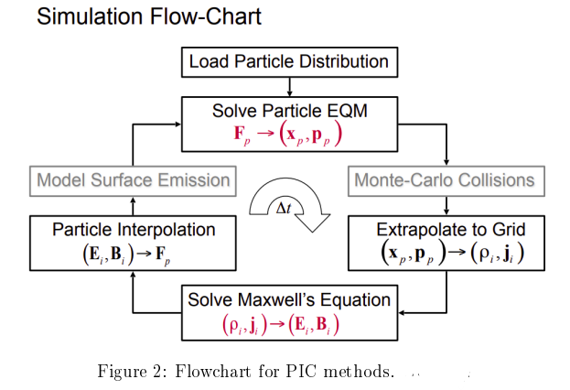
Gaps in the Literature-Contd.

Slide 10
Problem Definition
Our approach is similar to and differs from the general procedure outlined for Particle in Cell methods, in the following ways:
Sampling and Initialization Similar This step is similar to the first step in general PIC methods. We sample the initial positions and velocities of the particles based on some strategies like sampling from the Maxwell-Boltzmann distribution or uniform initialization strategies described in Methodology.
Action of fields on the particles Similar This step is similar to the second step in general PIC methods. We update the positions and particles of the particles according to the Boris Algorithm, based on the Lorentz force; as described in Methodology.
Particle deposition Skipped We skip this step in our approach for reasons described in the next step.
Fields generated Different As discussed earlier; when discussing the model used in the project, in devices such as those used in surface engineering processes, it is often the case that the electric and magnetic fields generated by the apparatus are far more stronger than those generated by the particles. So it is reasonable to assume that the fields generated by the particles are negligible compared to the fields generated by the apparatus. While general PIC methods compute fields generated by particles in the plasma, we only used fields generated by the apparatus. Since we neglect the fields generated by the particles in the plasma, we can skip depositing particles in the grid; which would be the third step of general outline of PIC methods. This makes our model simpler and easier to work with, evaluate and understand. We define the fields generated by the apparatus or field configurations based on analytic configurations and move the particles in the plasma under their influence. This is later described in methodology.
B.Tech. Mechanical Engineering/Production and Industrial Engineering/Mechanical with Specialization in Energy Engineering – First Review Presentation - SMEC

Slide 11
Problem Definition
5. Force on particles Skipped As we do not compute the electric and magnetic fields generated by the particles, this step is skipped and the action of the electric and magnetic fields created by the apparatus is done directly in step 6.
6. Action of the fields on particles Similar to the sixth step of general PIC methods, we repeat step 2 to move the particles under the influence of electric and magnetic fields created by the apparatus.
Our approach can be summarized in the following set of steps: Do for each batch of particles in the plasma stream:
Sampling and Initialization Kinetic Theory
2. Definition of fields Apparatus If required use a different field to simulate control of the apparatus, for example: changing the voltage of the electrode; changing the electric field. Do for certain number of time steps:
 Particle update based on Lorentz force Single particle dynamics
3. Remove particles
Surface Engineering process Particles are either absorbed to form a coating or exit the plasma chamber. The details are described later in methodology. The steps of our approach as described help us define our objectives as discussed in the following section

Slide 12
Objectives
The objectives of the project are based on our approach to the problem as described in problem definition:
Single Particle Method To simulate charged particles that evolve under the influence of electric and magnetic fields; as governed by the Lorentz force.
Field Configurations To simulate a few different configurations of electric and magnetic fields- some describing apparatus like coils; some describing analytic expressions for fields and to study the different evolution of particles.
Kinetic Theory To study different initial velocity distributions and how the velocity distribution of particles changes as the particles evolve. Parameters like the Plasma temperature are to be studied under this topic.
Analysis To analyze different batches or collections of particles, subjected to different field configurations.
B.Tech. Mechanical Engineering/Production and Industrial Engineering/Mechanical with Specialization in Energy Engineering – First Review Presentation - SMEC

Slide 13

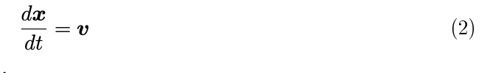
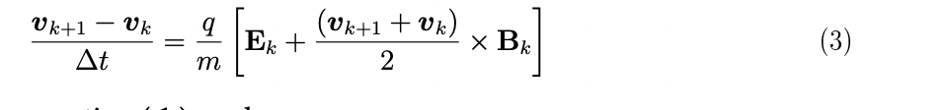
Methodology
Particle Evolution Single particle dynamics As discussed earlier, we evolve individual particles in the plasma with the Lorentz force. To achieve this in a simulation, the Lorentz force equations are discretized and then solved using the Boris Algorithm; a standard algorithm for simulating charged particles in electric and magnetic fields.
Lorentz Force The equations of motion for a charged particle under the influence of Electric and Magnetic fields is described by the Lorentz Force in the S.I. units as
as discussed earlier in equation (1); along with the expression for the velocity
These equations are discretized to obtain
B.Tech. Mechanical Engineering/Production and Industrial Engineering/Mechanical with Specialization in Energy Engineering – First Review Presentation - SMEC

Slide 14
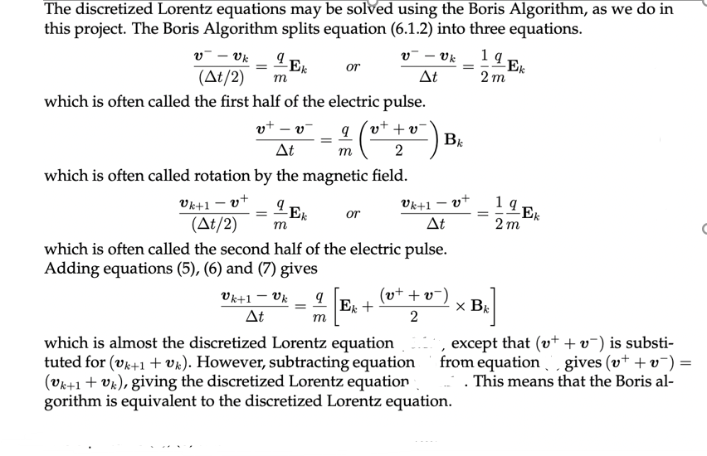
Methodology
3. Boris Algorithm

Slide 15
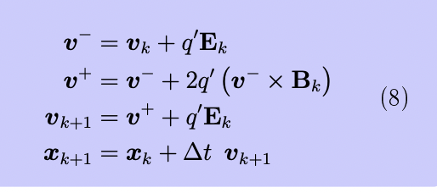
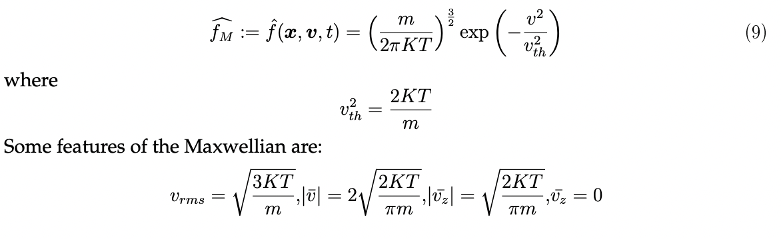
Methodology
The equations can be written slightly different as
4. Particle Sampling- kinetic theory As discussed earlier, kinetic theory of plasma uses density function and its evolution to describe a plasma. We pointed out that we will be using some aspects of kinetic theory in our project; in that we will initialize the batches (collections) of particles based on certain distributions. This will allow us to study parameters like the plasma temperature, in our project.
5. Maxwellian distribution
One important density function often used in the kinetic theory of plasma is the Maxwell Boltzmann distribution often called the Maxwellian which has the density function

Slide 16
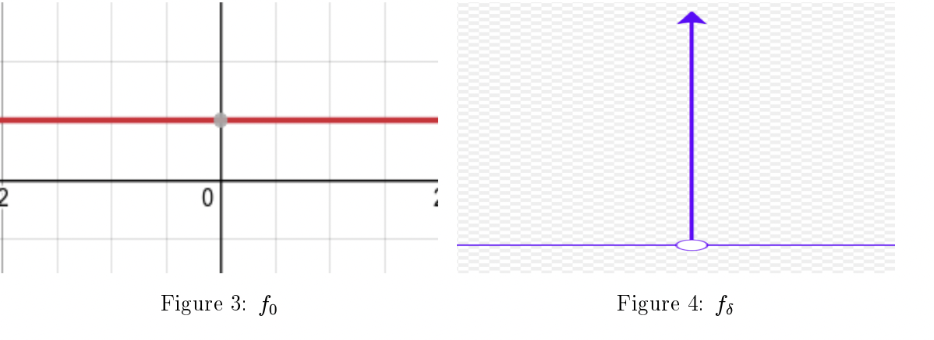
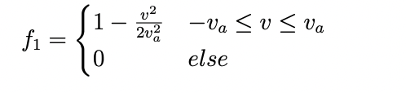
Methodology
6. Parabolic distributions
We are also interested in defining other density functions to do the sampling. The simplest density function to try would be to have all particles have the same velocity i.e. a Dirac delta function distribution. Another simple distribution would be a uniform distribution between two velocities, where a particle is equally likely to have any velocity in the range.
Functions that look like f0 might define he uniform distribution while functions like fδ might describe the Dirac delta distribution. The figure for f0 was generated using desmos graphing calculator while the figure for fδ was snipped from the image in wikipedia for the Dirac delta function. We define initialization strategies based on uniform and Dirac delta distributions in our simulations. Parabolic functions in a given range also seem like interesting distributions and yet simple to work with. After some trial and error, two functions that seem interesting are:

Slide 17
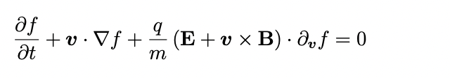
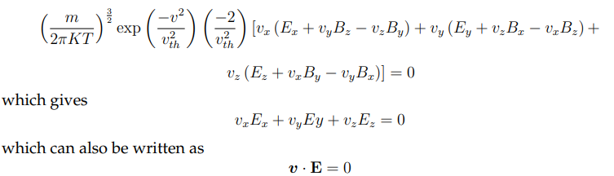
Methodology
7. A justification for Parabolic density functions - Vlasov equation
One good exercise is to check what happens when plugging in ˆf1 , ˆf2 and fM in the collisionless Vlasov equation. As discussed earlier Kinetic theory of plasma describes the system with a density function. The dynamics of the plasma is described by the changing of the density function. Earlier, Boltzmann equation was discussed as an equation used to describe this dynamics. Vlasov equation is an instance of the collisionless Boltzmann equation discussed earlier; where it is assumed that the particles do not interact with each other, and the force exerted on the particles is described by the Lorentz force. The Vlasov equation is written as:
For the Maxwellian function the equation now becomes,

Slide 18
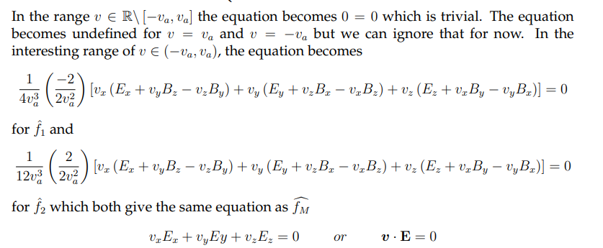
Methodology

Slide 19
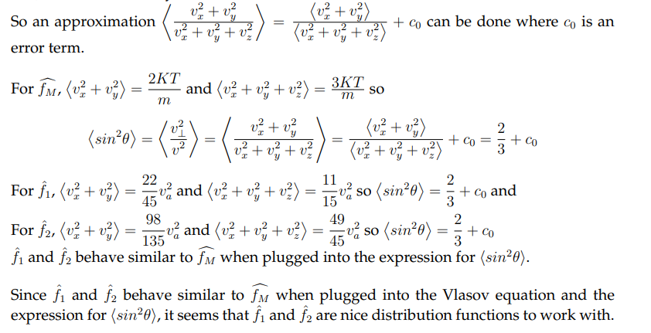
Methodology
8. A justification for Parabolic density functions - Magnetic mirror

Slide 20
Methodology
9. Fields
In order to define the plasma chamber and hence the control on the plasma, we are interested in defining a few different electric and magnetic field configurations. We have a few different field configurations in mind. For the electric field, as of now we have 2 field configurations:
Uniform electric field The electric field has the same value everywhere. It is a very simple configuration to think about and use.
2. Electric field due to an electrode We describe the electrode in the following way: Every particle sees the electrode create an electric field created by a pair of capacitor plate at a distance taken only in the x-y plane. This is to say that every point on the electrode; now assumed to be a line along the z-direction, creates an electric field like that created between a pair of capacitor plates, if there is a particle at the same z-coordinate as that point. So currently we use the expression E = V · dr where dr is a vector whose z-coordinate is zero.
10. Running different batches
As discussed earlier we would like to describe different batches of particles, so as to model plasma streams; where the particles are sent into the chamber based on different initialization strategies. The particles are then evolved based on the Boris algorithm. We would then remove the particles to simulate particles exiting the chamber, or being absorbed to form coatings as in different surface engineering processes like Magnetron Sputtering.

Slide 21
Work carried out so far
The simulation is programmed in jupyter notebook files (.ipynb extensions) that run python and markdown. The notebooks are available in the following Github repository, in the notebooks folder.
GitHub repository: https://github.com/18BME2104/MagneticMirror
Algorithm Outline
Different aspects of the program are discussed based on the different notebooks (ipynb files) that describe them.
Required functionalities and Files:
Constants - constants.ipynb
Particle - particle.ipynb
Electric and Magnetic fields - field.ipynb
Particle initialization - sampling.ipynb
Updating the particles - step.ipynb
Batches of updates - run.ipynb
Plotting - plot.ipynb
B.Tech. Mechanical Engineering/Production and Industrial Engineering/Mechanical with Specialization in Energy Engineering – First Review Presentation - SMEC

Slide 22
Work carried out so far
1. Constants - constants.ipynb
The constants.ipynb notebook describes some constants useful in the program. Some useful constants are e (electron charge) me (electron mass), charges and masses of ions in the plasma, a.m.u (atomic mass unit), N_{A} (Avogadro’s number), (permittivity of vacuum), µ₀ (permeability of vacuum), K or k_{B} (Boltzmann’s constant), etc.
2. Particle - particle.ipynb The particle.ipynb notebook describes the state of a particle; its position, velocity, mass, charge, name, and optionally acceleration (which is set to 0 as default if it is not required to track the acceleration of a particle) as of now. Currently the Boris algorithm as discussed earlier, is an update strategy defined to update the state of a particle. Other strategies could be defined in new functions in the class. However, Boris algorithm is good enough for us to get started.
Electric and Magnetic fields - field.ipynb Electric and Magnetic field configurations described in field.ipynb. Currently Uniform Electric field and the Radial Electric field (the field depends on the particle’s position) created by an electrode are available to set up electric fields. Uniform Magnetic field and Magnetic field created by a Helmholtz coil and that by two Helmholtz coils are available

Slide 23
Work carried out so far
4. Particle initialization - sampling.ipynb The initial positions and velocities of the particles play an important role in the evolution of their state under the influence of electric and magnetic fields. The initial distribution of positions and velocities define where the particles start in the setup (or lab apparatus); for example where they are injected into a sputtering chamber through valves, and what velocities they start with; for example what potential they are accelerated through or what parameters were used for the pumps used to pump the particles in.
5. Updating the particles - step.ipynb The Step class is concerned with initializing particles, defining the fields, and updating the states of the particles (positions and velocities) under the action of electric and magnetic fields
To use sampled positions and velocities that have been saved in csv files, some reading functionality is useful to load these positions and velocities to be used during initialization.

Slide 24
Work to be done
Work on the constants.ipynb, particle.ipynb, fields.ipynb and sampling.ipynb has been done to a certain extent. Basic work on step.ipynb has been done. However, we could modify functionalities defined here and add other definitions as work on run.ipynb progresses, so that everything works well together. Other functionalities that could be added are:
Sampling : Sampling strategies based on parabolic density functions discussed earlier are yet to be defined. New sampling strategies such as one initializing particles with the same Kinetic energy; as would happen if particles (of possibly different species) were accelerated through the same potential difference, could be defined.
Fields : New field configurations could be defined. We could also modify existing field configuration like the Electric field due to an electrode; if we find a different expression to describe it better, or if the current expression does not work well. However, we do not yet have a plasma simulation running. The major portion of the work to be done to achieve this includes working on the run.ipynb notebook. To be able to understand the simulation; to check if works correctly and to understand the plasma behavior, we also need to define functionalities to plot different parameters like particle positions and velocities. These functionalities will be defined in plot.ipynb notebook, which can be imported into ryn.ipynb and step.ipynb notebooks to plot these quantities when the simulation is running, or from saved data
B.Tech. Mechanical Engineering/Production and Industrial Engineering/Mechanical with Specialization in Energy Engineering – First Review Presentation - SMEC

Slide 25
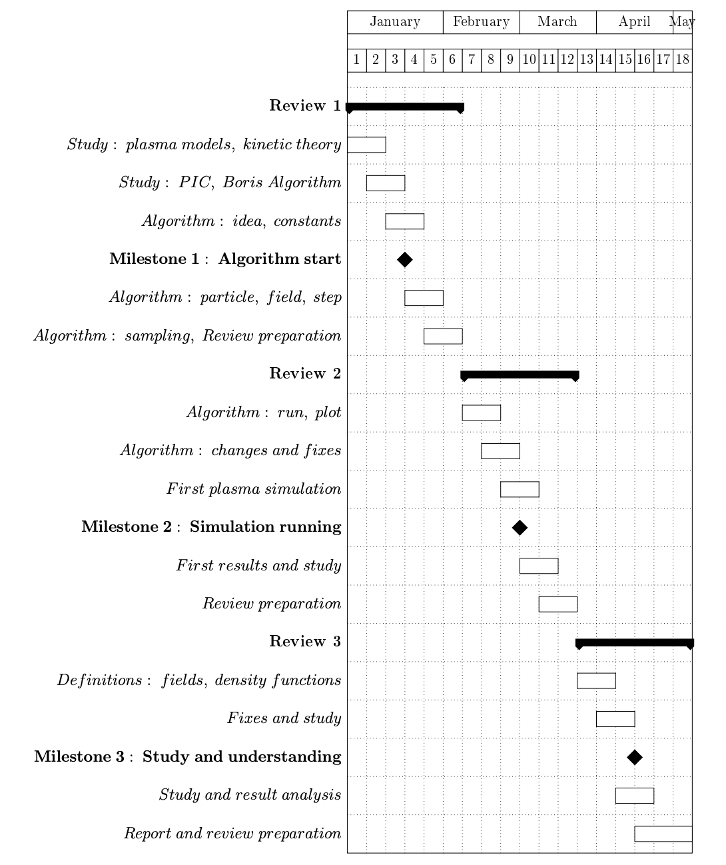
Gant Chart (Work plan)
B.Tech. Mechanical Engineering/Production and Industrial Engineering/Mechanical with Specialization in Energy Engineering – First Review Presentation - SMEC

Slide 26
Milestones in the project phase
Milestone 1 Algroithm start Week 3 - Achieved
Around week 3 we had some understanding of basic plasma physics and so started working on how to formulate the problem as an algorithm. (Before review 1)
Milestone 2 Simulation running Week 9 - Expected We expect to have the simulation running around week 9 of the project. This will allow us to have some preliminary results and understanding of our model, by re- view 2. (Before review 2)
Milestone 3 Study and understanding Week 15 - Expected We intend to perform study on plasma using our algorithm and improve our un- derstanding of a plasma and how to control and study a plasma system before the end of the project. (Before review 3)
B.Tech. Mechanical Engineering/Production and Industrial Engineering/Mechanical with Specialization in Energy Engineering – First Review Presentation - SMEC

Slide 27
References
[1] Chen, F. F., “Introduction to plasma physics and controlled fusion”, New York: Plenum press, 1984. - [6] Myers, A., Colella, P., & Straalen, B. V. (2017).
[2] Myers, A., Colella, P., & Straalen, B. V. (2017)., “A 4th-Order Particle-in-Cell Method with Phase-Space Remapping for the Vlasov–Poisson Equation” ,SIAM Journal on Scientific Computing, 39(3), B467-B485.
[3] Qin, H., Zhang, S., Xiao, J., & Tang, W. M. (April, 2013), “Why is Boris algorithm so good?” .Princeton Plasma Physics Laboratory, PPPL-4872. Other References
[1]Na, Yong-Su (2017), “Introduction to nuclear fusion” (Lecture 9 Mirror, lecture slide). SeoulNational University Open Courseware. [2] Föreläsning (2009), “Charged particle motion in magnetic field” , (lecture slide). Luleä Uni-versity of Technology. [3] Professor Sitaram Dash. (Fall Semester 2021)., “MEE4005 Surface Engineering” (lecturenotes). SMEC, VIT Vellore. [4] Matthew W. Kunz. (November 9, 2020), “ Introduction to Plasma Astrophysics” (lecturenotes). Princeton Plasma Physics Laboratory. - we learned about introductory concepts on plasma
B.Tech. Mechanical Engineering/Production and Industrial Engineering/Mechanical with Specialization in Energy Engineering – First Review Presentation - SMEC

